Slide 1
THE Quiz Application
Hishaam Basheer (764002894)
Ahmed Saeed (421008064)
Sharifa BinSulaiman-AlMalik(402008070)

Slide 2
Introduction
This Assignment is about designing a Java based quiz application with GUI
The Quiz includes Multiple Choice Questions and True/False Questions
The goal is to make the quiz engaging ,easy to use and visually appealing

Slide 3
The Task At Hand
To build a quiz application that is user-friendly and engaging, and unique by combining an interactive UI, competitive features, and an efficient scoring system, to ensure that the quiz is visually appealing and well structured

Slide 4
Best UI/UX Design practiceS
Practices | Source
Reuse components Accessibility Feedback testing | The UX Writers Guide to Figma from figma.com
Reuse components Use a predictable and cohesive interface Minimize redundant work | Importance of Design of Consistency from uxpin.com
Accessibility/User-Centric Design Clarity and Simplicity Feedback testing | Best UX design Practices from lucidspark.com

Slide 5
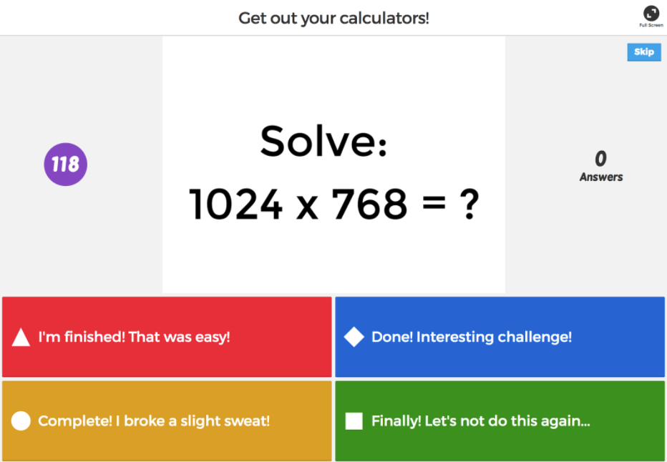
Best UI/UX Design practiceS

Slide 6
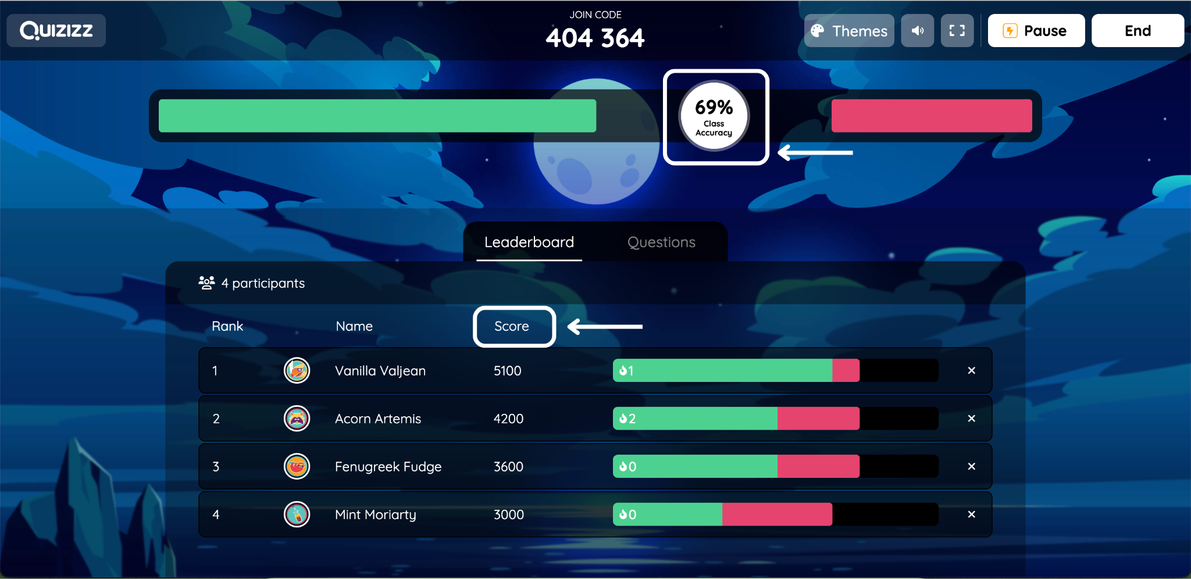
Best UI/UX Design practiceS

Slide 7
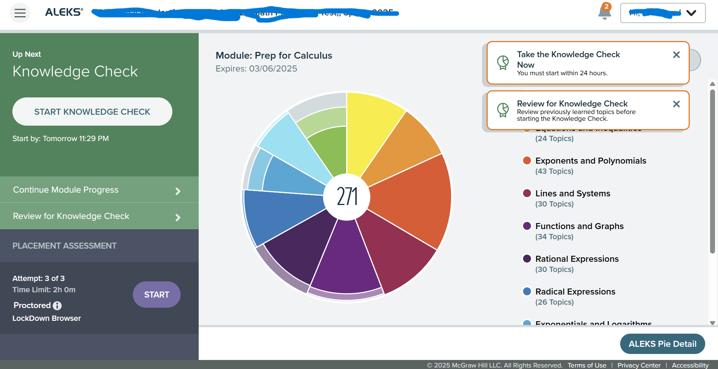
Best UI/UX Design practiceS

Slide 8
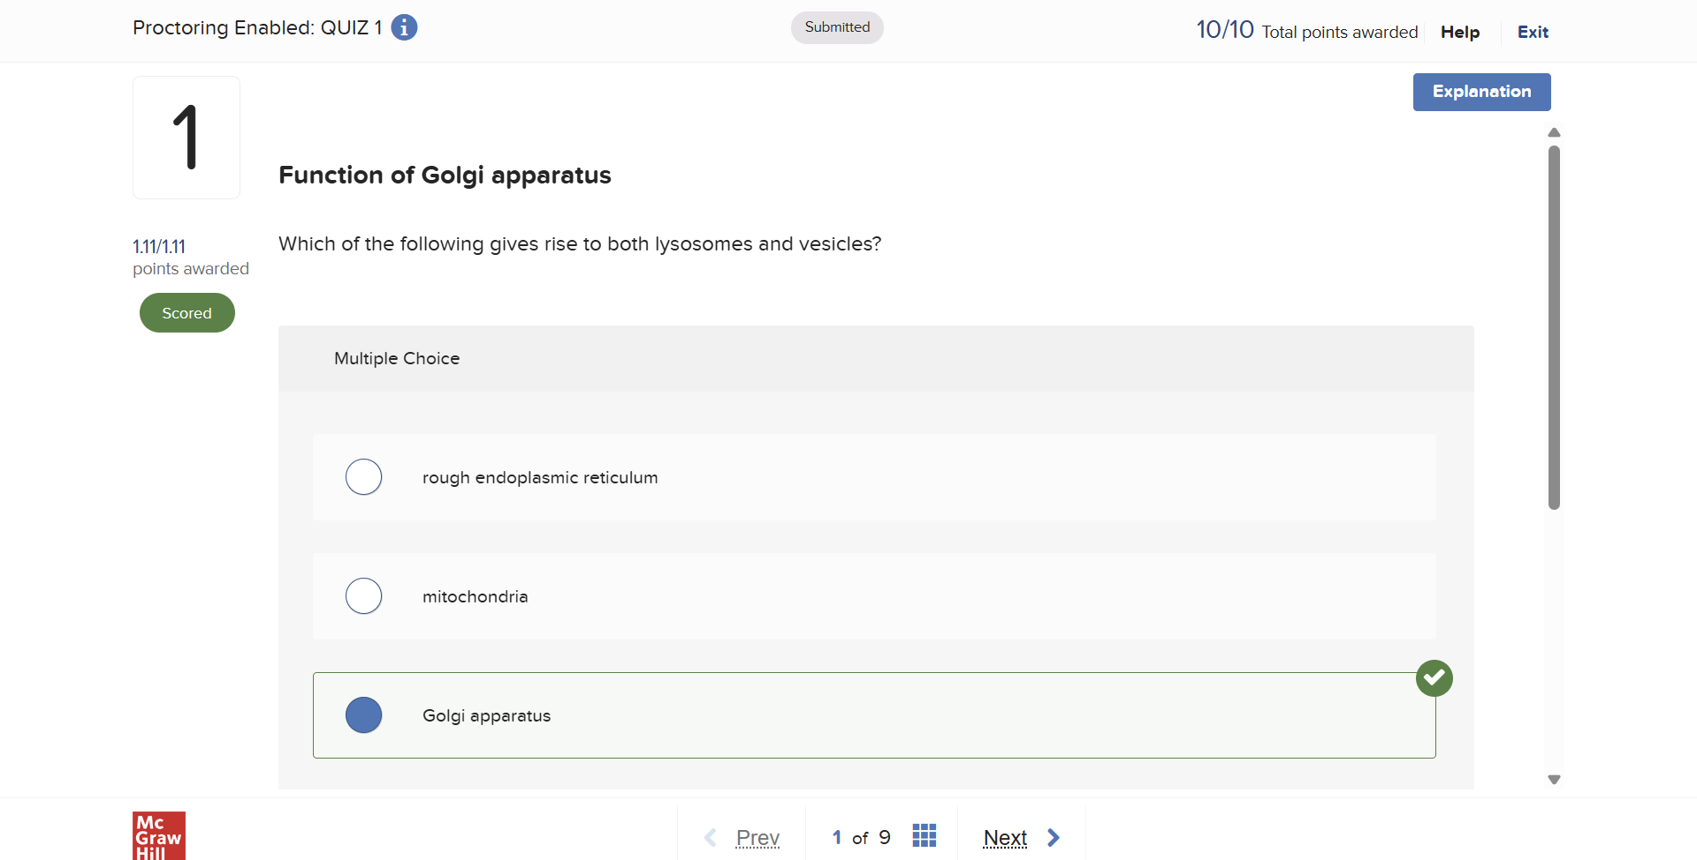
Best UI/UX Design practiceS

Slide 9


Competitor Analysis
The two most widely known quiz sites are Quizizz and Kahoot.
PvP
Powerups to shake up the tempo
Purple
Not very balanced
Immediate feedback

Slide 10


Competitor Analysis
The two main platforms used by RIT Dubai are McGrawHill Education and Aleks (Also from McGrawHill)
Lockdown Browser
Individual Attempts
Provides helpful hints
No feedback until after the quiz

Slide 11
Competitive advantages
Why Our Quiz is Better !
Instant feedback
A colourblind high contrast mode
The ability to select the number of questions you wish to answer

Slide 12
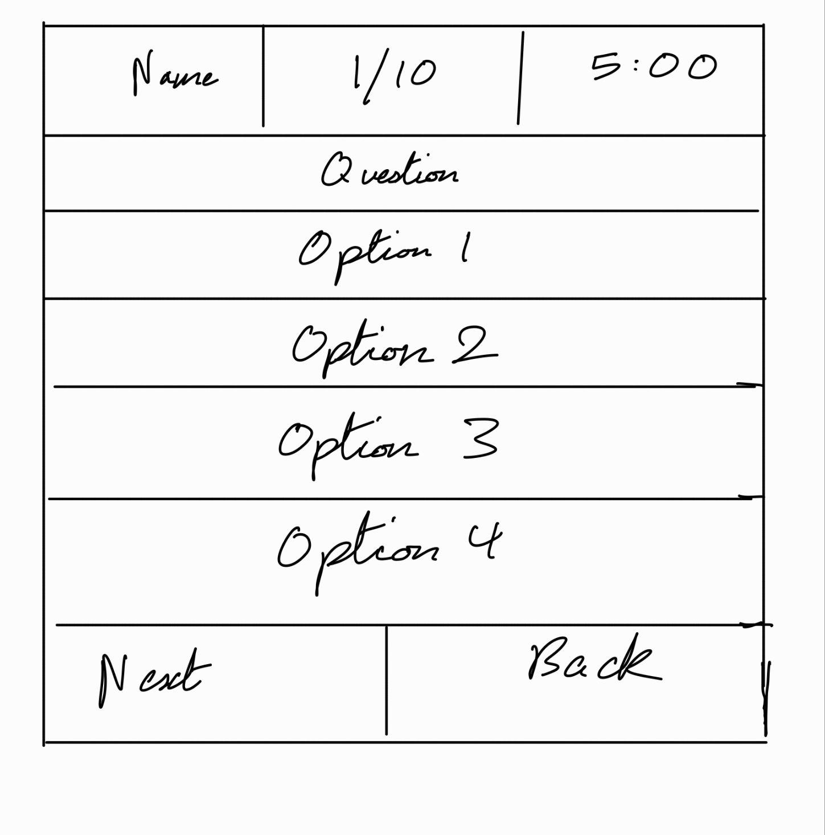

Slide 13
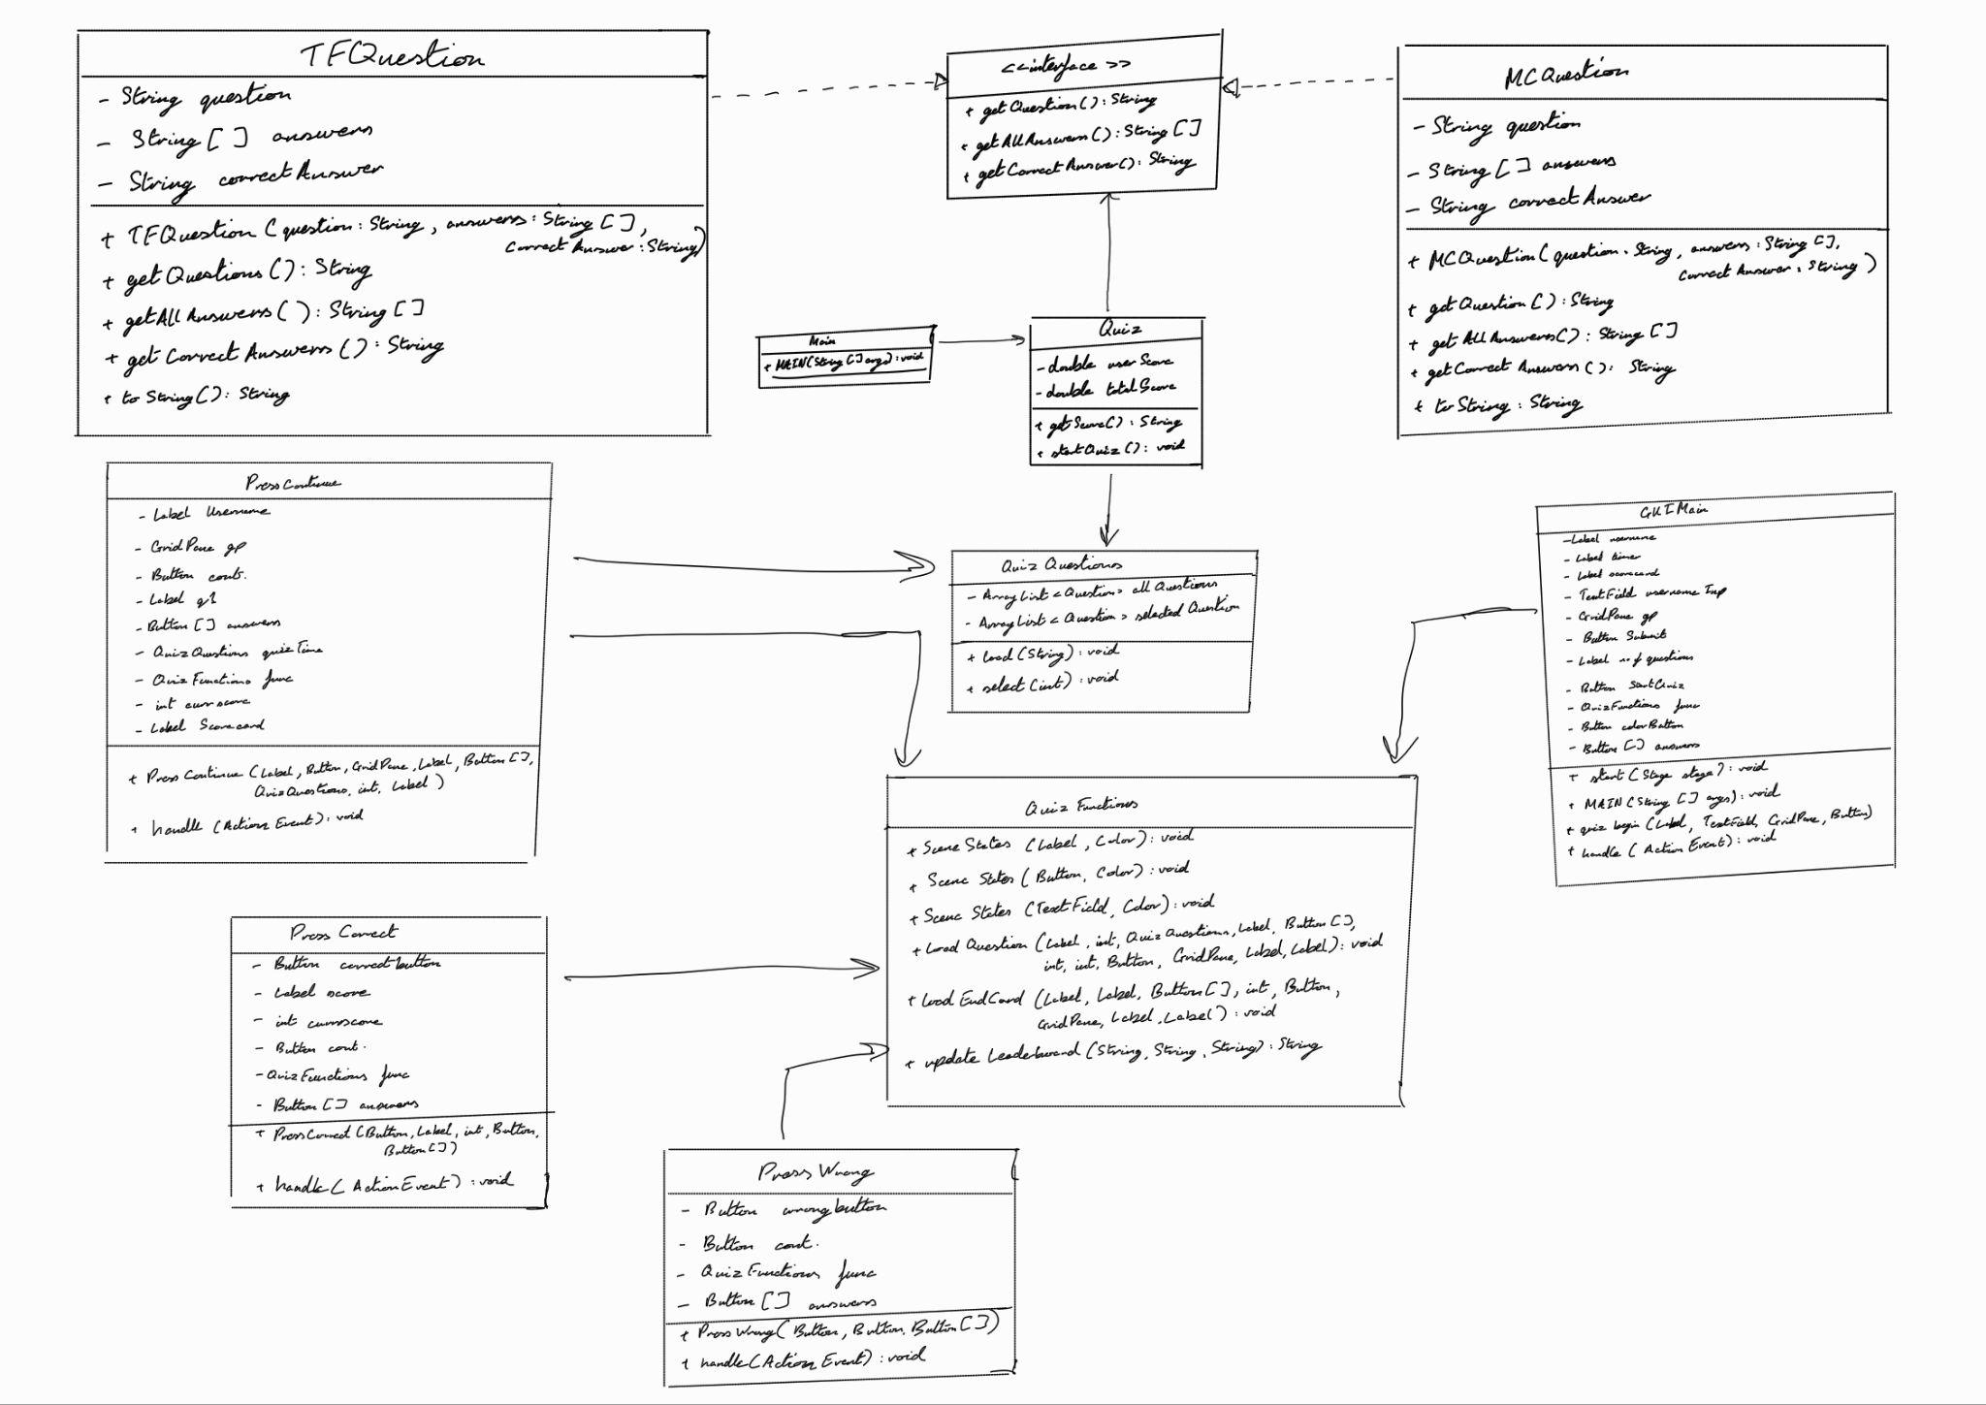

Slide 14
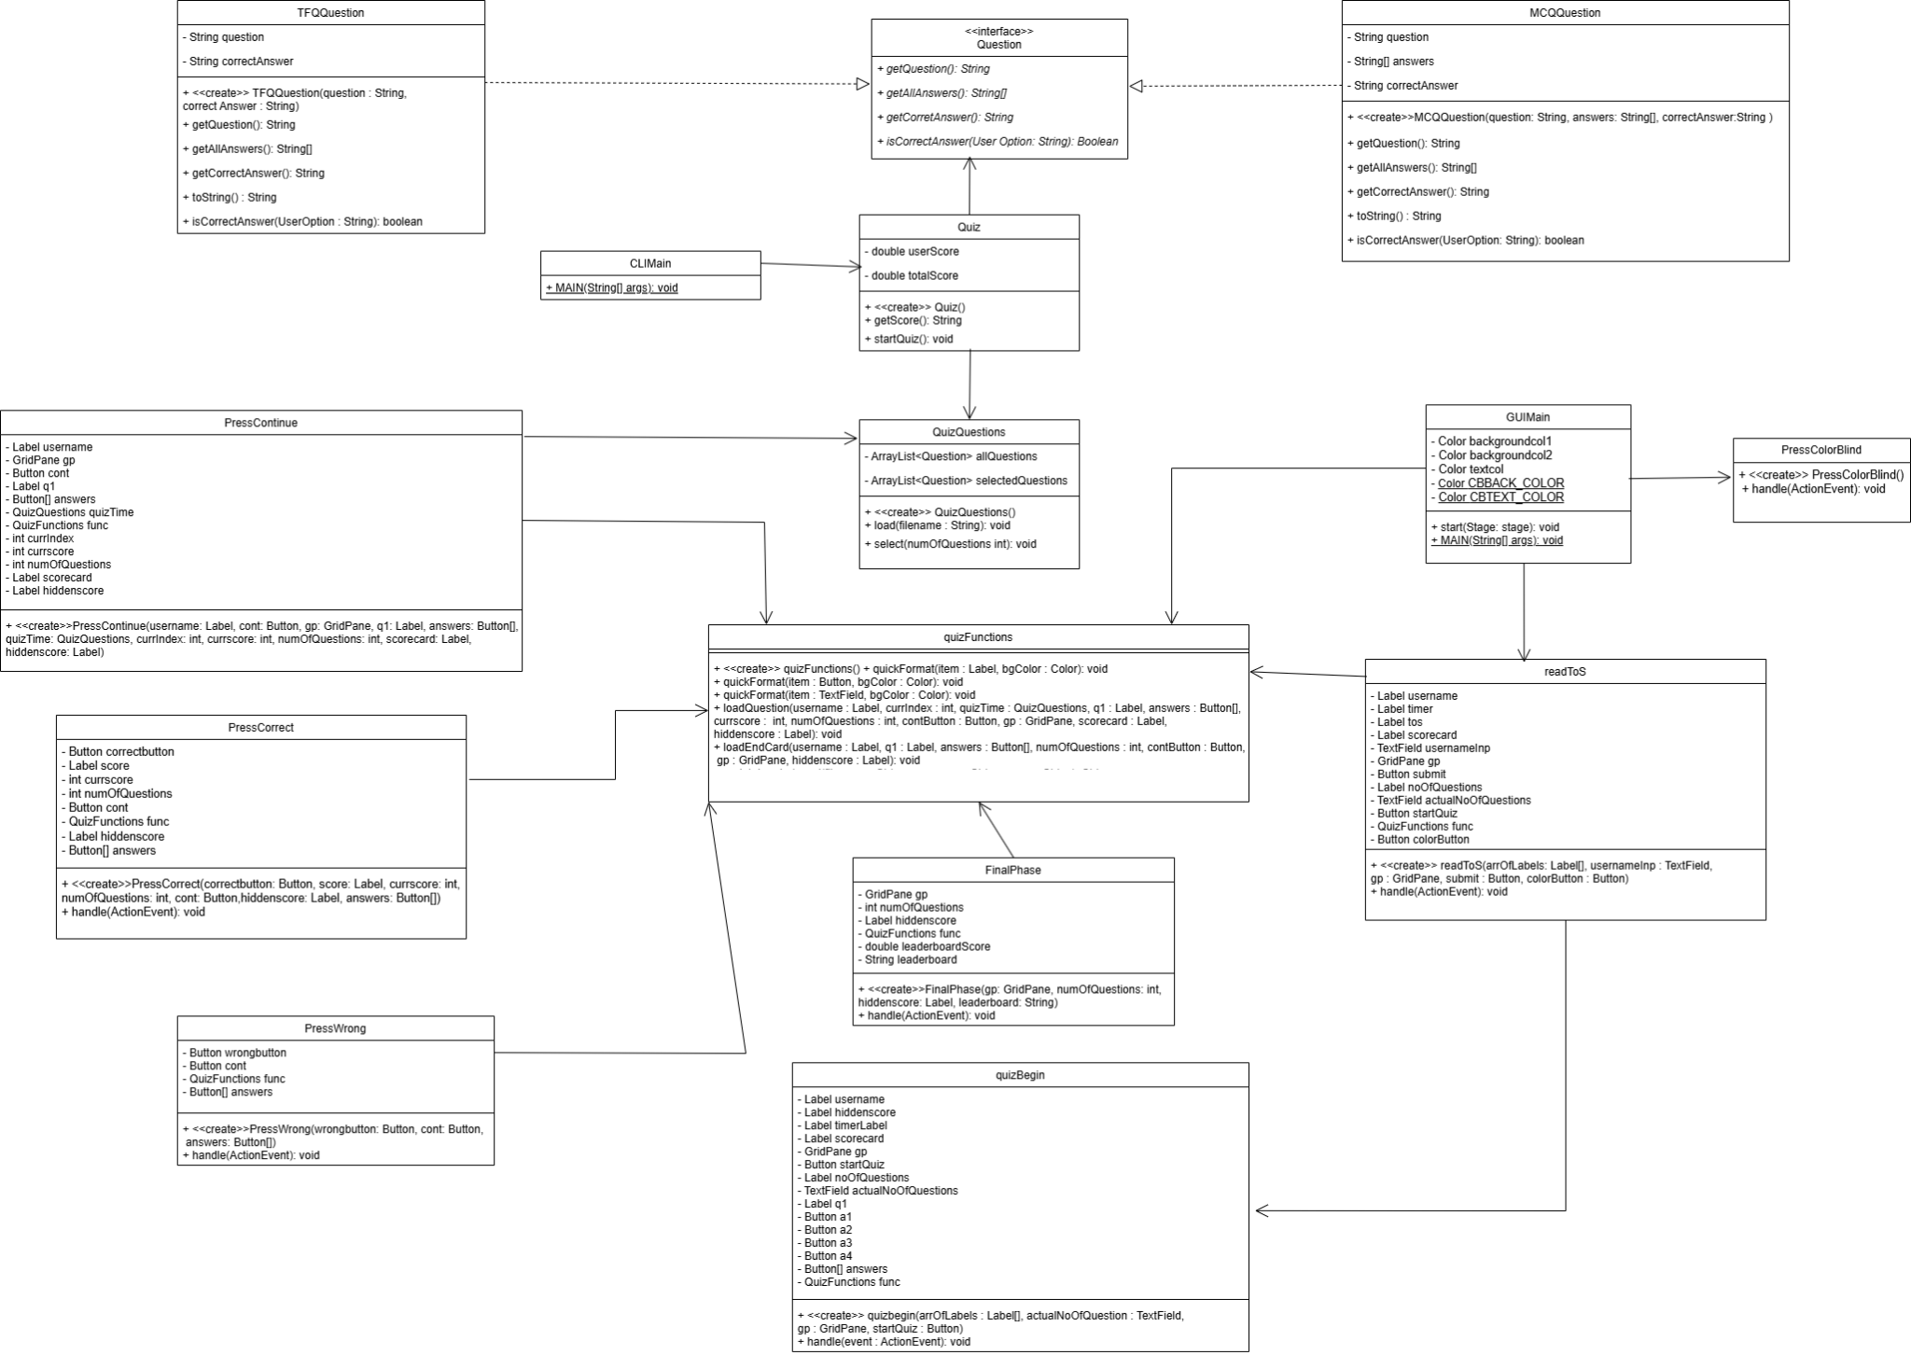

Slide 15
Features
Building the GUI: Making sure its attractive
Leaderboard
Timer

Slide 16
What Makes us Stand out
Terms of Service
Colorblind Mode
Variable Difficulty

Slide 17
Our Default Colors
#C1F7DC
#C3D2D5

Slide 18
Our High Contrast Colors
for Colour Blind Mode
#1F449C
#F05039

Slide 19
Our Challenges
Challenges include complexity with Text-To-Speech
Ensuring the UML is accurate
Minimizing arguments required for class construction
Making sure the user cannot Change Answers
Handled
Not Implemented
Handled
Handled

Slide 20
Future improvements
More Question types!
Text-To-Speech
Multiplayer Mode
Dark Mode Options
Sound effects after separate actions
More Difficulty Options

Slide 21
Conclusion
We built a structured and user friendly quiz using Java and GUI
Future updates will enhance features and user experience

Slide 22
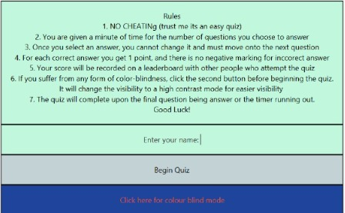
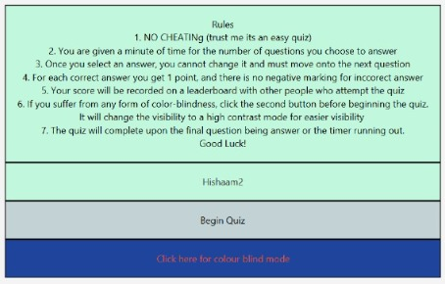
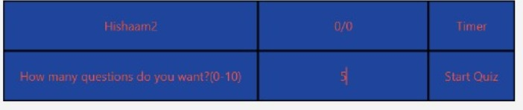


Slide 23
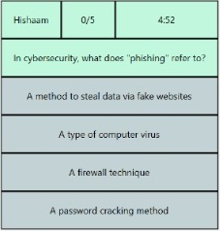
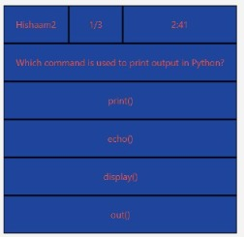

Slide 24
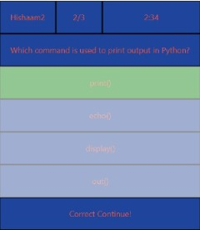
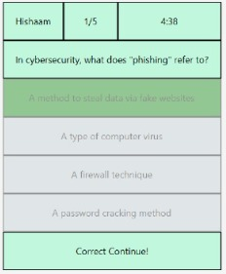
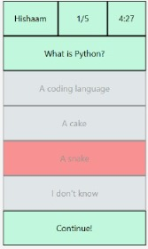
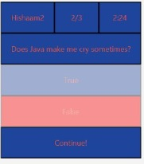

Slide 25
